Slide 1
Steam Game Database
By Paing Hein Kyaw and Aye Thwe Tun
Team #11
CIS 22C

Slide 2
Steam Game Database
Search for the games you want within the vast array of our database.
Add or delete games according to what you like and don’t like.
Print the database sorted by the genre of the games you love.

Slide 3
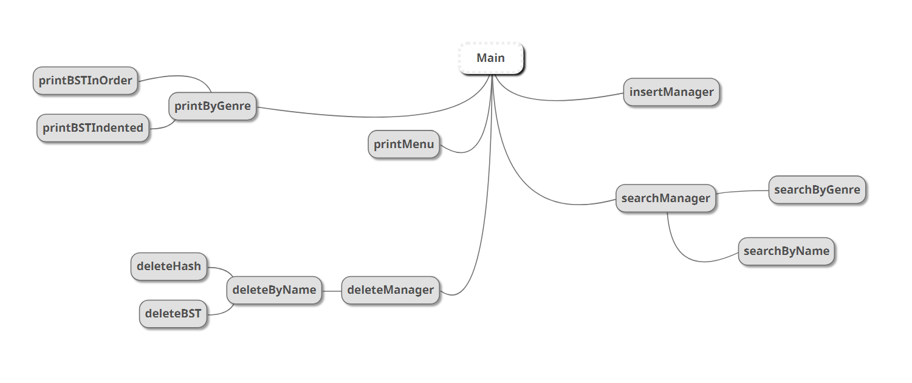
Data Structure Chart

Slide 4
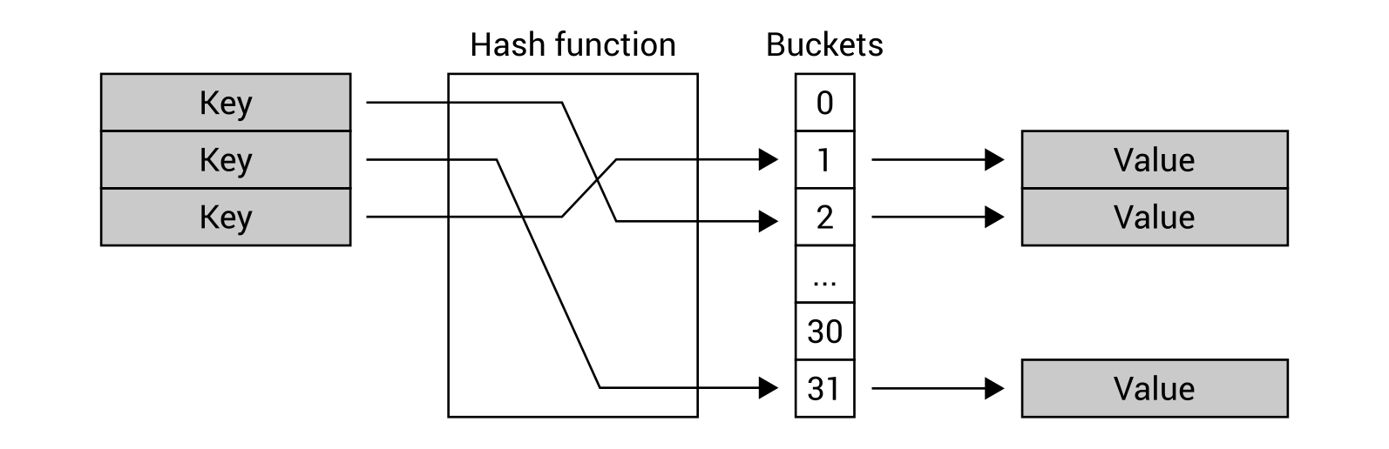
Data Structure Design for HashTable
Linked Lists

Slide 5
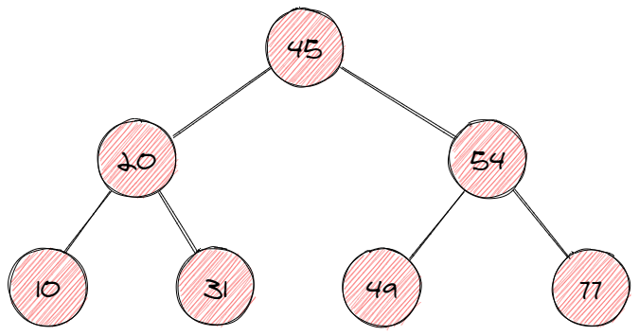
Data Structure Design for BST

Slide 6
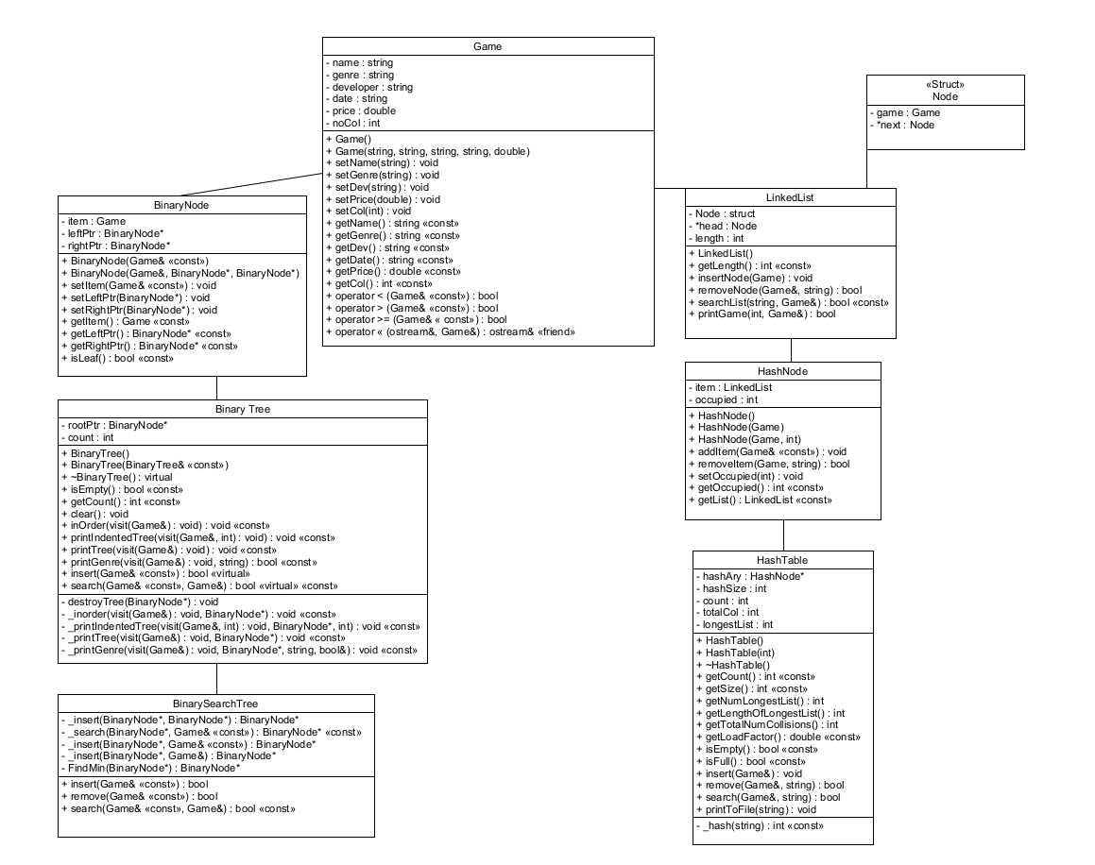
UML Diagram

Slide 7
Project Assignments
Unit 1: Team Coordination – Paing Hein Kyaw
Unit 2 : BST Algorithms – Aye Thwe Tun
Unit 3: Hash List Algorithms – Paing Hein kyaw
Unit 4: Screen output – Aye Thwe Tun
Unit 5: File I/O – Paing Hein Kyaw
Test Plan, Presentation Outline – Aye Thwe Tun/Paing Hein Kyaw
Project Documentation – Paing Hein Kyaw/Aye Thwe Tun

Slide 8
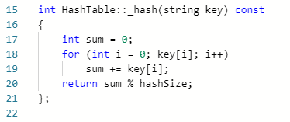
Hash Function

Slide 9
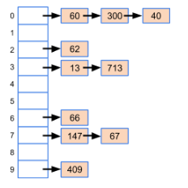
Collision Resolution Method
The collision resolution method we used is linked list via chaining.
This allows us to store more data in a relatively smaller hash size.
It is also more efficient and convenient to search for the data in the linked lists.

